Slide 1

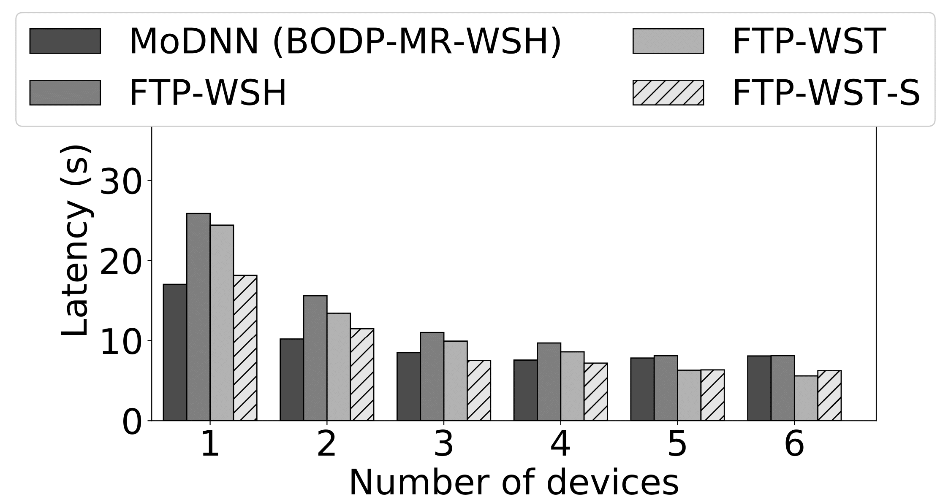
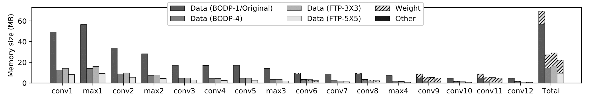
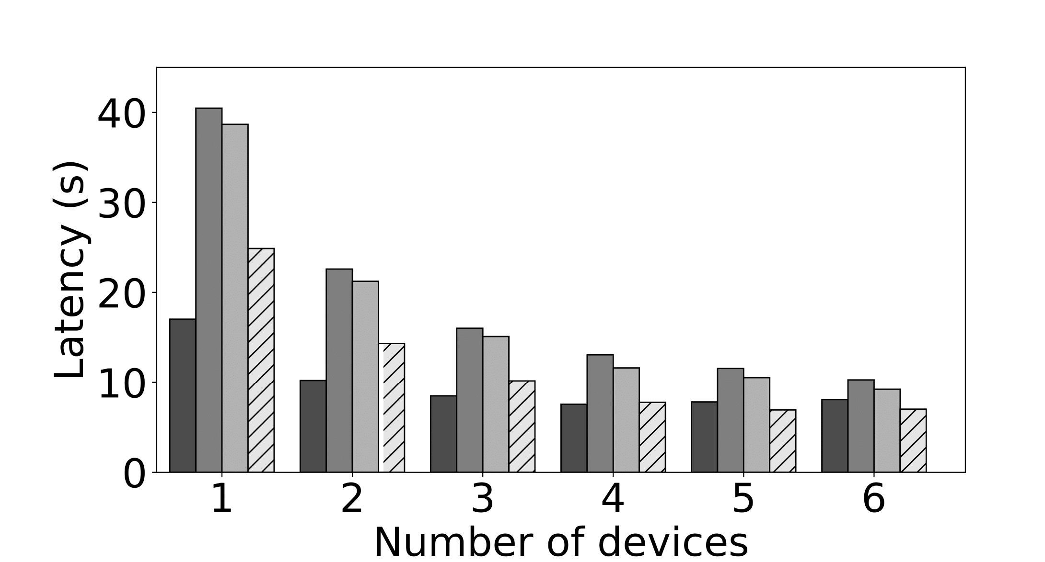
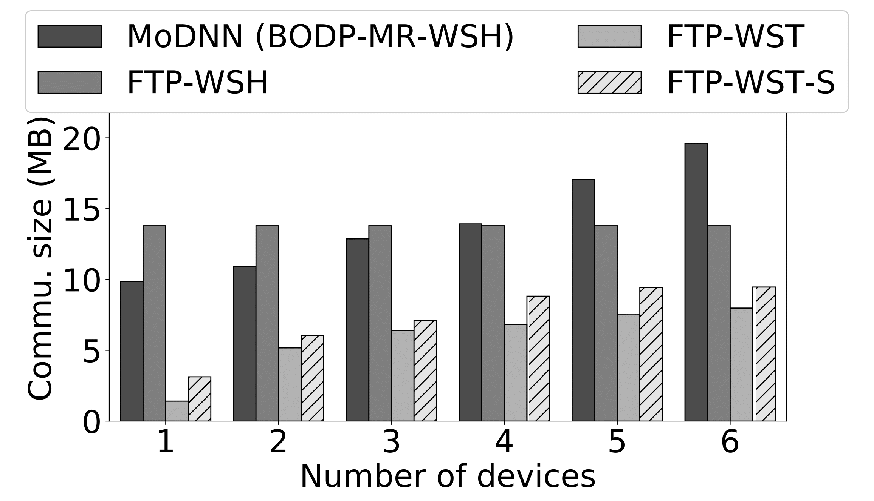
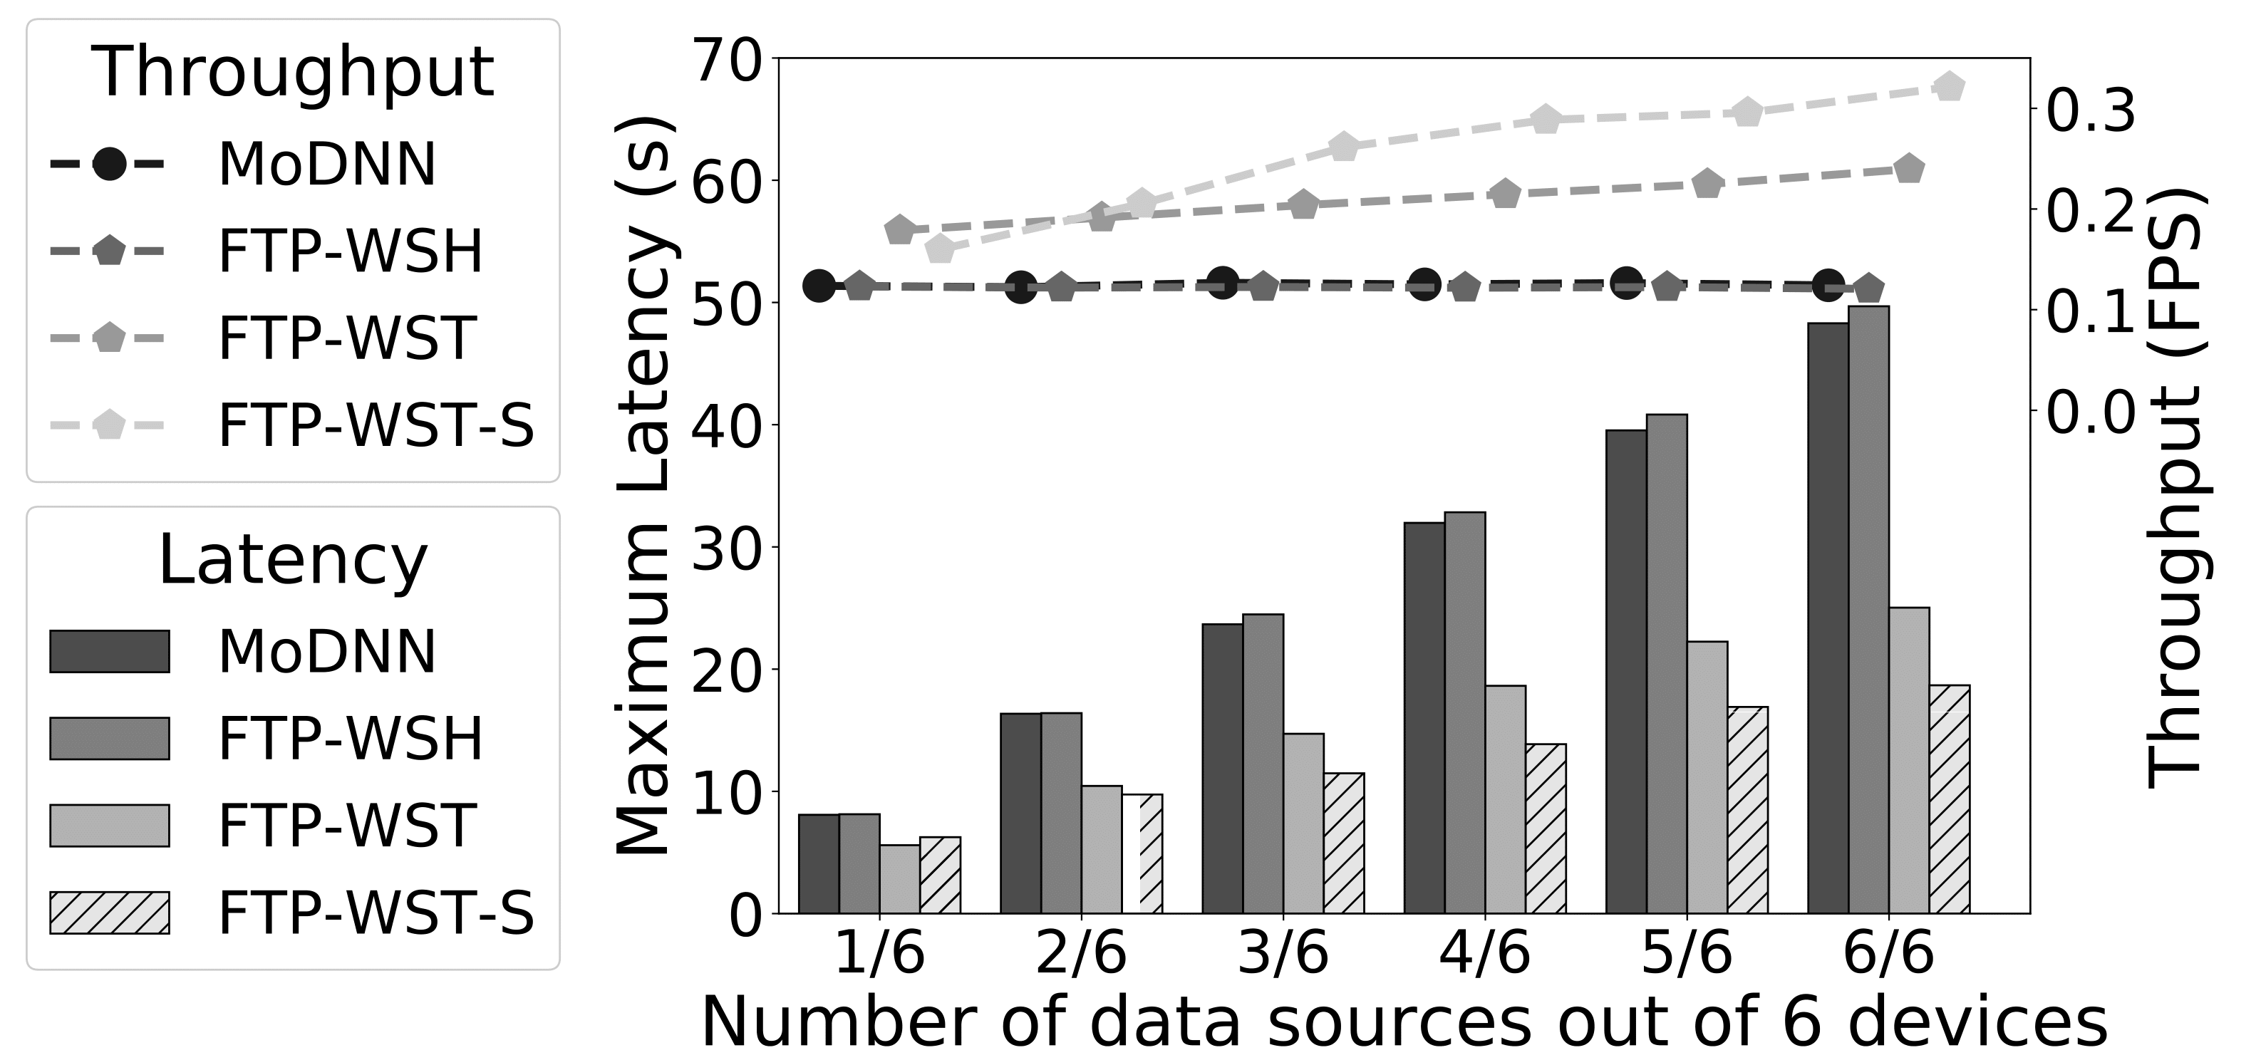
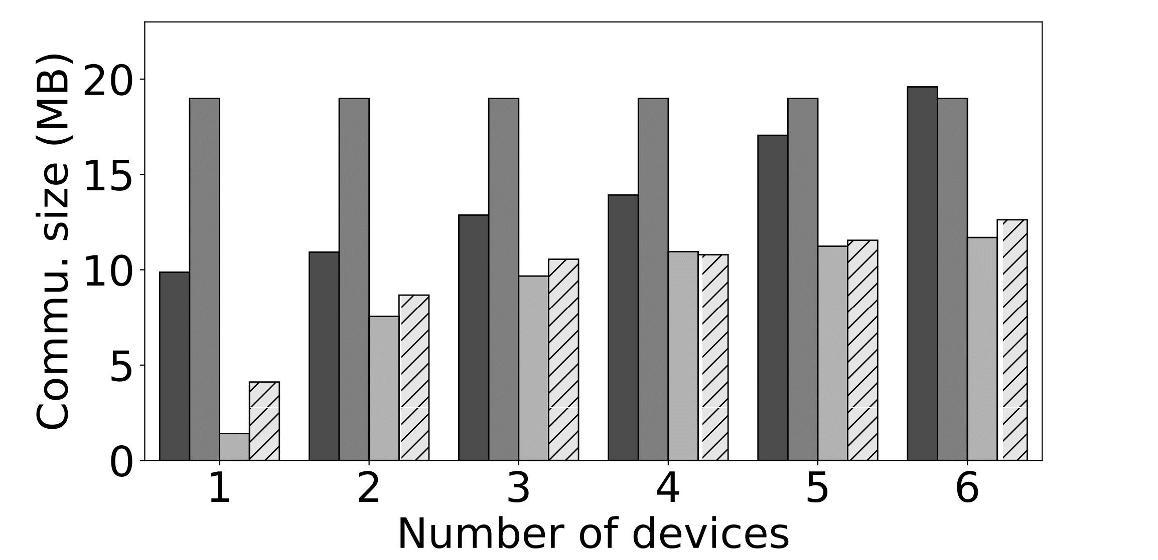
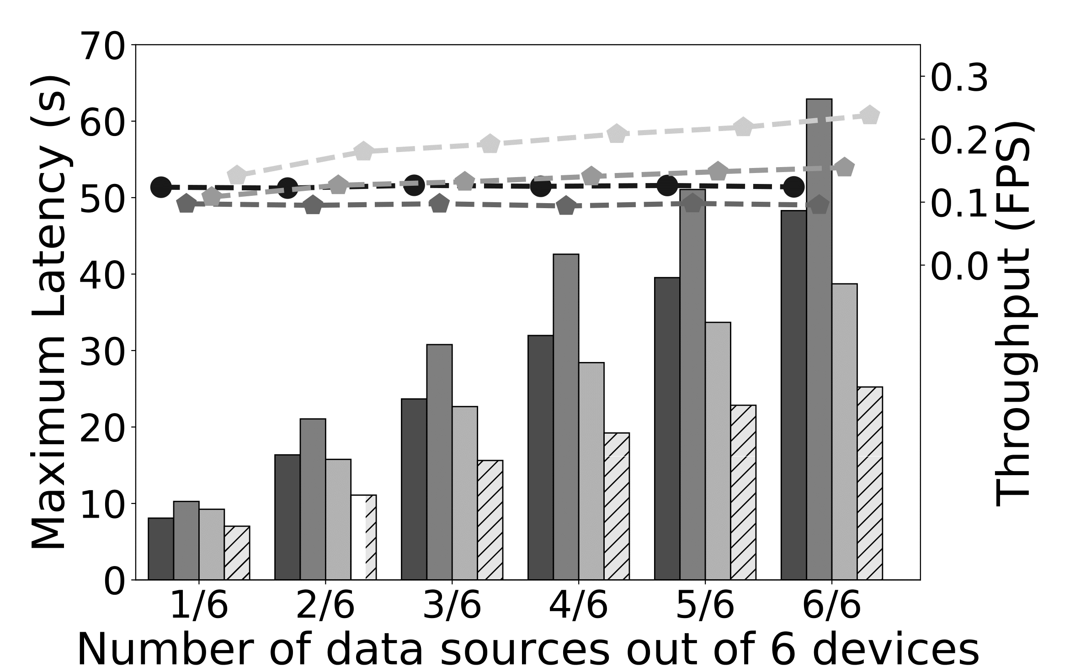

DeepThings: Distributed Adaptive Deep Learning Inference on Resource-Constrained IoT Edge Clusters
Zhuoran Zhao, Kamyar Mirzazad and Andreas Gerstlauer
Electrical and Computer Engineering
The University of Texas at Austin
Overview
Background and Motivation
DeepThings Overview
Internet-of-Things (IoT)
Complicated and noisy sensing scenarios
Large scale data processing & analytics
Deep learning (DL) techniques for IoT applications
Computational and memory-intensive
Cloud-based vs. fog/edge computing
Privacy
Unpredictable remote server and communication latency
Computational resources near the sources
Edge and gateway devices
Deep learning inference in IoT edge clusters
Efficient deployment on resource-constrained IoT devices
Fused Tile Partitioning (FTP)
Input data tiling
Layer fusion
Distributable tasks with lightweight data synchronization
Distributed work stealing runtime system
Gateway: central coordination
Edge: peer-to-peer work stealing
Collaborative inference
DeepThings: distributed adaptive deep learning inference on resource-constrained IoT edge clusters
DeepThings Framework
Fused Tile Partitioning (FTP)
Distributed Work Stealing
Convolutional operation
Local connectivity between neurons of consecutive layers
Grid partitioning with boundary consideration
Chain of multiple convolutional layers
Large amount of intermediate data
Boundary synchronization overhead per layer
Layer fusion
Independent execution stacks
Distributed work stealing in local wireless area network
Source data partitioning & inference task generation
Peer-to-peer data & task migration
Gateway-managed load balancing
Local inference using external library
Message flow between edge and gateway devices
Edge Node Runtime
Work stealing service
Serve work stealing
Send results to gateway
CNN inference service
Partition data frames
Process partitioned data
Perform work stealing
Data Reuse-Aware Work Scheduling
Redundancy in Fused Tile Partitioning
Duplicated overlapped data for independent sub-tasks
Overlapped data amplified through many fused layers
Possible data reuse to reduce computation
FTP partition scheduling
Minimize the partition dependency
Scheduling tasks to be stolen in dependency order
Caching overlapped reuse data in gateway
Gateway Runtime
Work stealing service
Round-robin scheduling
Collect results from edge nodes
CNN inference service
Merge FTP partition results
Process remaining layers
Experimental Results
Experimental Setup
Memory Footprint
Latency & Throughput
Open-source framework
Retargetable implementation in C
TCP/IP socket APIs
Released in open-source form
Experiment platform
Raspberry Pi 3 Model B
Up to 6 nodes in WLAN over WiFi
Deep leaning application
You Only Look Once object detector
First 16 layers
Multiple data sources
Experimental parameters
Per device memory footprints of each layer
Maximum memory usage reduction
61% in 4-way BODP, 58% and 68% for FTP 3x3 and 5x5
Average memory footprint reduction per layer
67% in 4-way BODP, 69% and 79% for FTP 3x3 and 5x5
Single data source
6.8s with 3.5x speedup in FTP-WST-S, 6-device network
8.1s with 2.1x speedup MoDNN, 6-device network
Scalability benefits in DeepThings
FTP: Avoid intensive intermediate data exchange
WST: Adaptively use communication bandwidth and exploit communication overhead
Data-reuse aware scheduling reduces 27% latency
FTP – 3x3
Communication Overhead
FTP – 5x5
 | DeepThings | MoDNN
Partition Method | Fused Tile Partitioning (FTP) | Biased One-Dimensional Partition (BODP)
Partition Dimensions | 3x3 ~ 5x5 | 1x1 ~ 1x6
Distribution Method | Work Stealing (WST) Work Sharing (WSH) | Work Sharing (WSH)
Edge Node Number | 1 ~ 6
Work sharing (WSH)
MoDNN: Communication overhead increases linearly with device number because of layer-based data exchange
FTP-WSH: Communication overhead is fixed
Work stealing with scheduling (WST-S)
An average of 52% reduction comparing with WSH
Overhead in data reuse, amortized by smaller input data
Multiple data sources
Maximum latency
MoDNN: proportional with number of sources
FTP-WST-S: 3.1x with data source(s) increasing from 1 to 6
Throughput
MoDNN: 0.12 FPS with 6 data sources
FTP-WST-S: 0.29 FPS with 6 data sources
FTP – 3x3
FTP – 3x3
FTP – 5x5
FTP – 5x5
Supported by National Science Foundation (NSF) Grant CNS-1421642

